Slide 1

PROGRESSIVE GROWING OF GANS FOR IMPROVED QUALITY, STABILITY, AND VARIATION
7109053105 何玟嫺

Slide 2
Content
INTRODUCTION
GAN & PROGAN
PURPOSE
MODEL
ARCHITECTURE
EQUALIZED LEARNING RATE
PIXEL NORMALIZATION
MULTI-SCALE STATISTICAL SIMILARITY
EXPERIMENTAL RESULT
MY EXPERIMENT

Slide 3
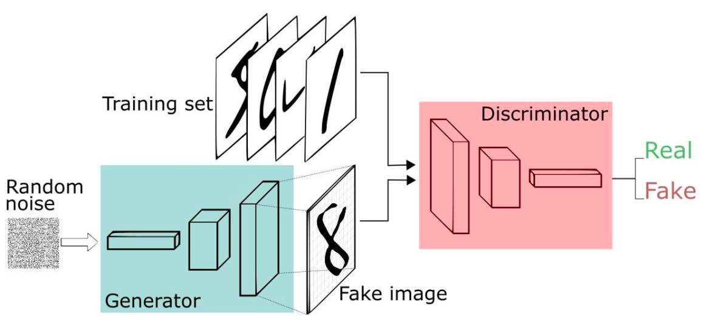
GAN

Slide 4
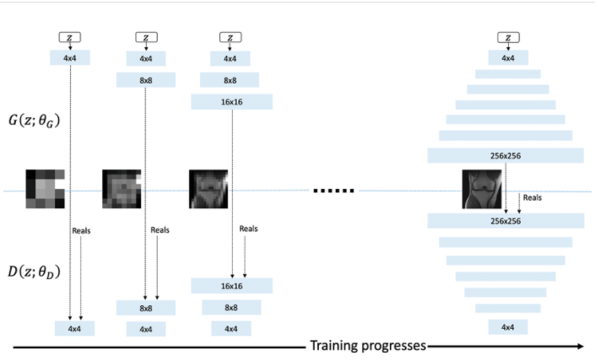
PROGRESSIVE GROWING OF GANS (PROGAN)

Slide 5
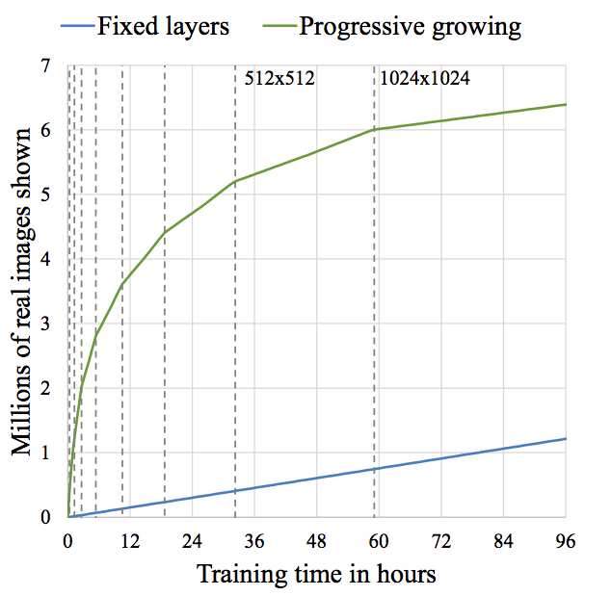
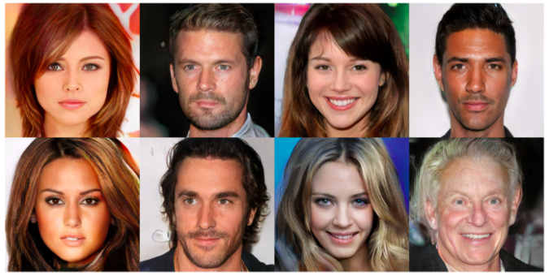
PURPOSE
Generates high-quality images
Speeds up training time

Slide 6

ARCHITECTURE
Phase 1
Real image
X (4x4)
Discriminator
D(X)
Z
(1x1)
Generator
Z : Random code
X : Generated image
Phase 2
Real image
X (8x8)
Downsample
Discriminator
D(X)
Z
Generator
Upsample
.
.
.

Slide 7

ARCHITECTURE
Generator
Upscale 2x
kxk
To RGB Layer
k/2xk/2
8x8
16x16
Z
4x4
. . .
α
+
X’
Z : Random code
X’ : Generated image
α : parameter that control ”fade in”
1-α
${Loss}_{G}$ = - D(x’)

Slide 8
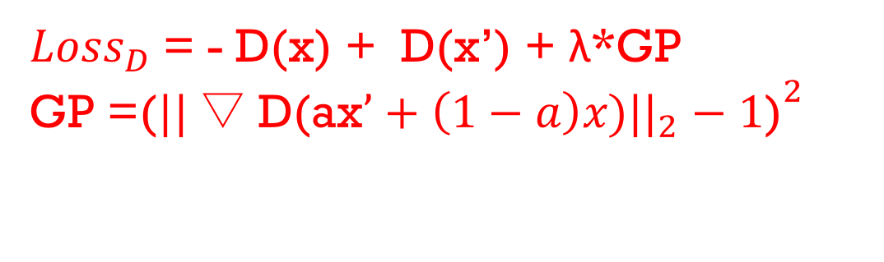
ARCHITECTURE
Discriminator
Downscale 0.5x
kxk
x : Input image
α : parameter that control ”fade in”
From RGB Layer
Minibatch Deviation Layer
α
k/2xk/2
16x16
8x8
x
. . .
4x4
D(x)
+
1-α
${Loss}_{D}$ = - D(x) + D(x’) + λ*GP
GP =(${{||▽\text{D}\text{(}\text{ax}’+\left(1−a\right)x\text{)||}}_{2}−1\text{)}}^{2}$

Slide 9
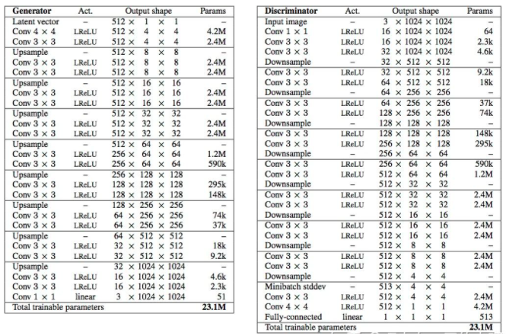
ARCHITECTURE

Slide 10
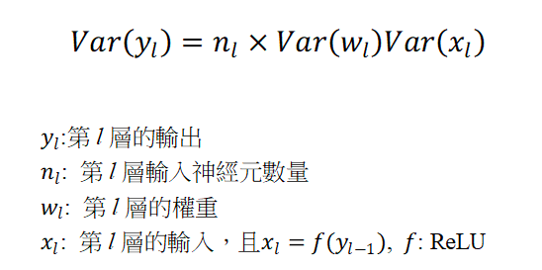
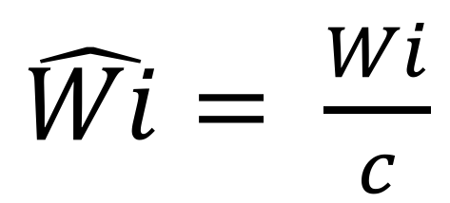
EQUALIZED LEARNING RATE
$\hat{Wi}= \frac{Wi}{c}$
weights
per-layer normalization constant from He’s initializer

Slide 11
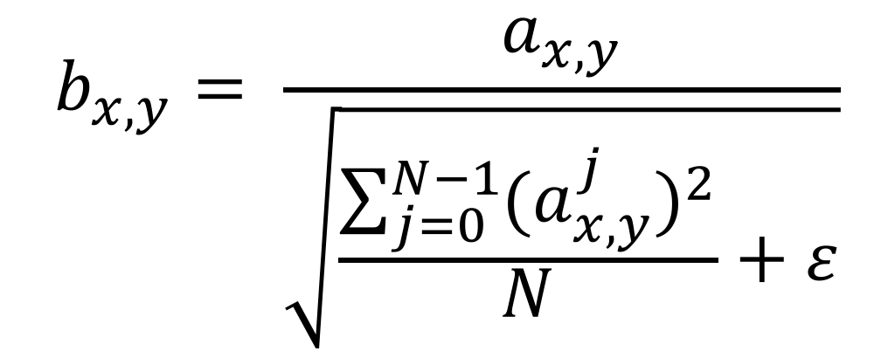
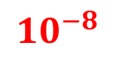
PIXEL NORMALIZATION
$$b_{x,y}= \frac{a_{x,y}}{\sqrt{\frac{\sum_{j=0}^{N−1}{{{(a}_{x,y}^{j})}^{2}}}{N}+ε}}$$
Original feature vector
Number of color channel
Normalized feature vector
$${10}^{−8}$$
Number of feature maps

Slide 12
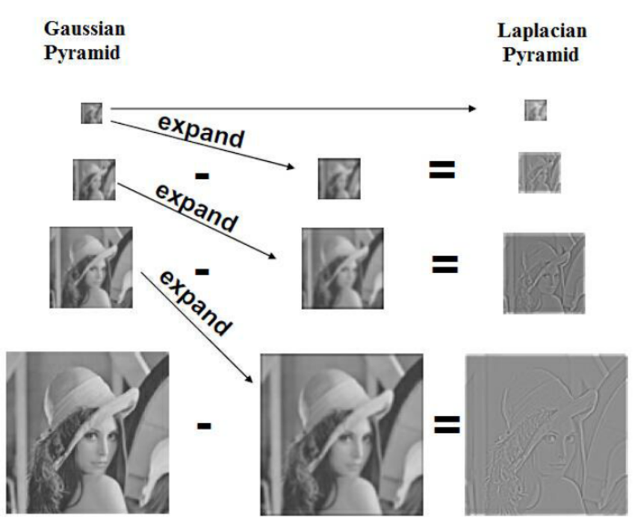
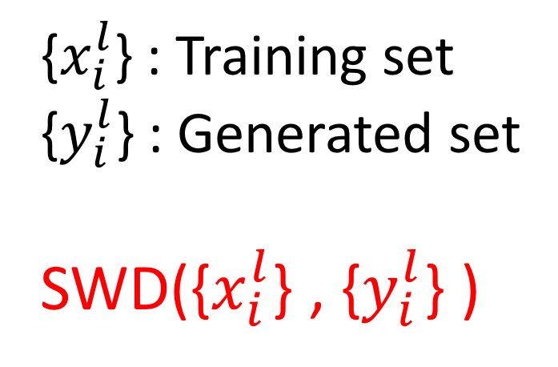
MULTI-SCALE STATISTICAL SIMILARITY
{$x_{i}^{l}$} : Training set
{$y_{i}^{l}$} : Generated set
SWD({$x_{i}^{l}$} , {$y_{i}^{l}$} )
Sliced Wasserstein Distance

Slide 13
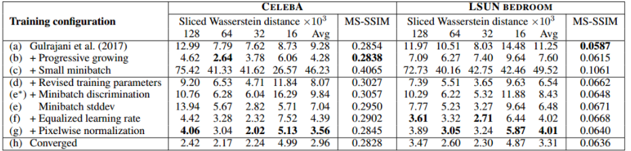
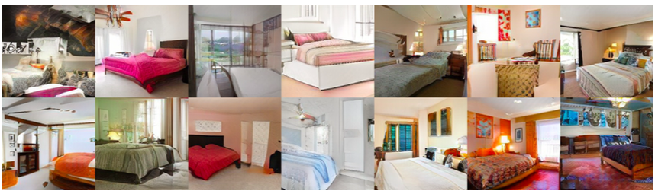
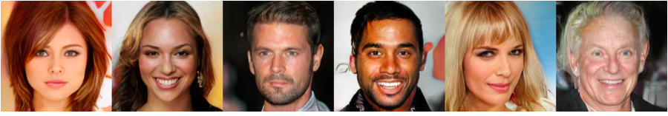
EXPERIMENTAL RESULT
(more than 200K celebrity images)

Slide 14
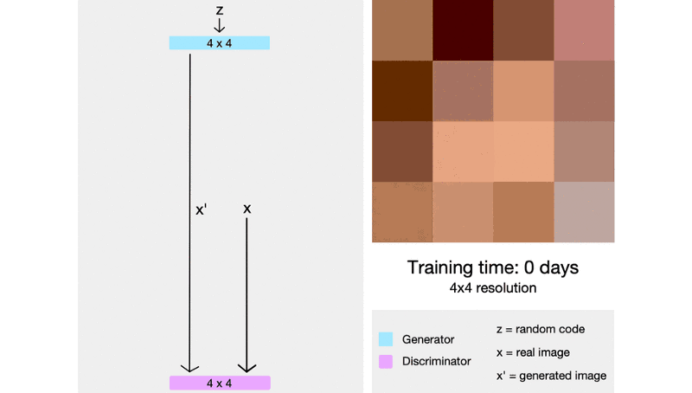
EXPERIMENTAL RESULT

Slide 15
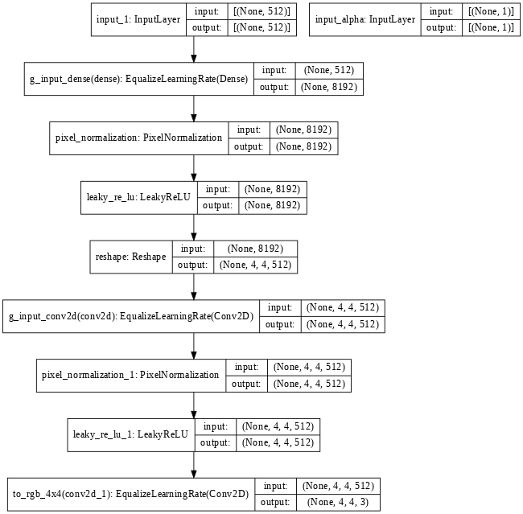
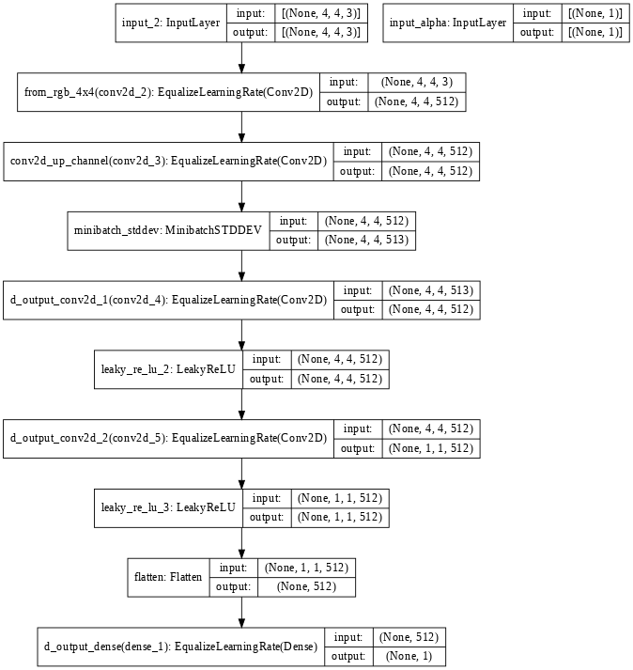
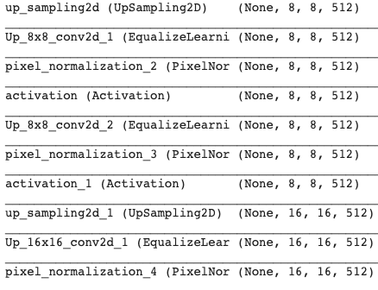
MY EXPERIMENT
Generator Discriminator

Slide 16
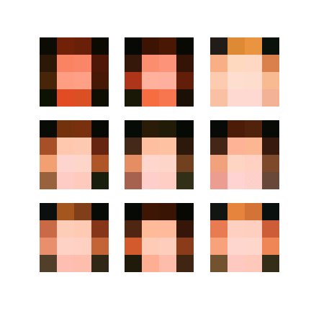
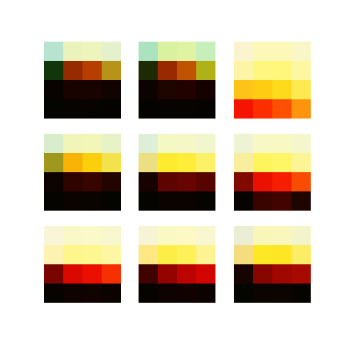
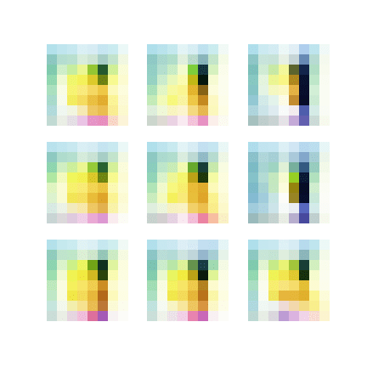

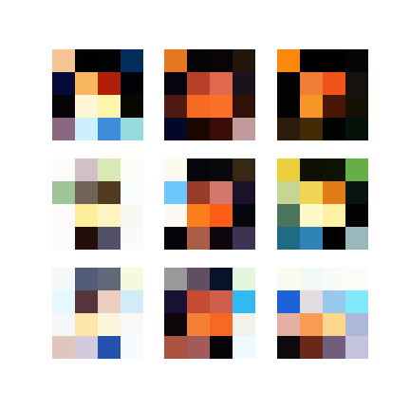
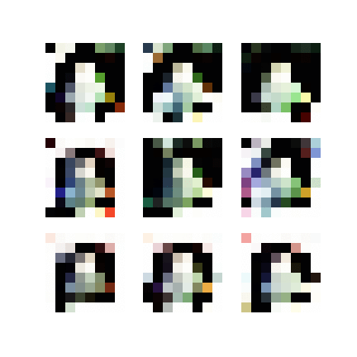
MY EXPERIMENT
Dataset：CELEBA
Epochs：40 / each image size
Batch size：16
Image_size 4x4 8x8 16x16
Training sample：
400張
2000張

Slide 17
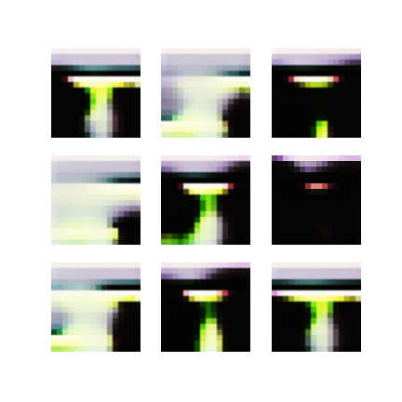
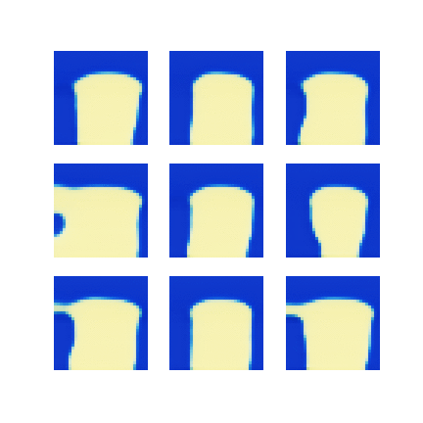
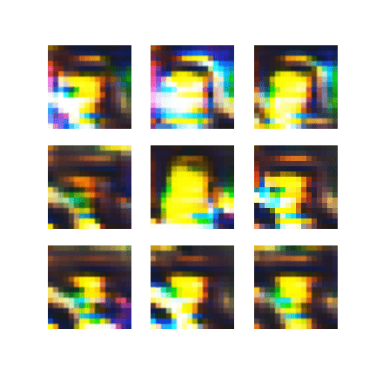
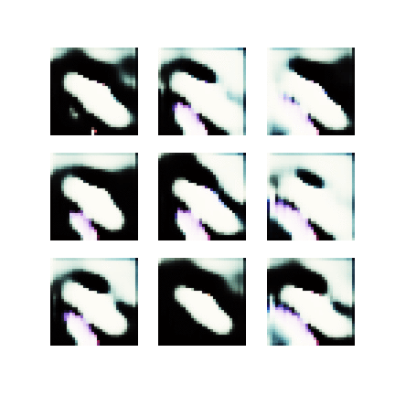
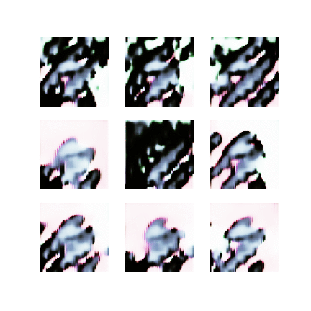
MY EXPERIMENT
Epochs：40 / each image size
Batch size：16
32x32 64x64 128x128
Training sample：
400張
2000張

Slide 18
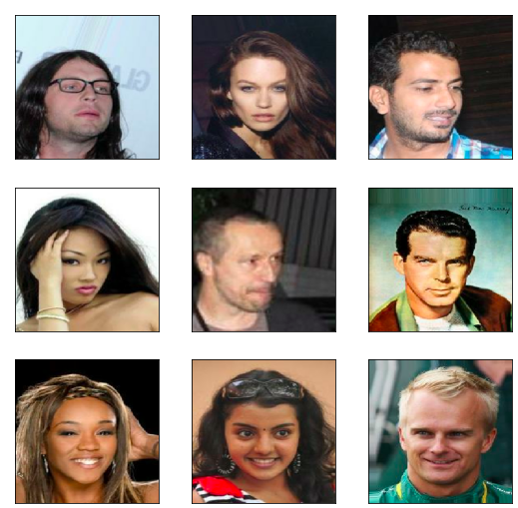
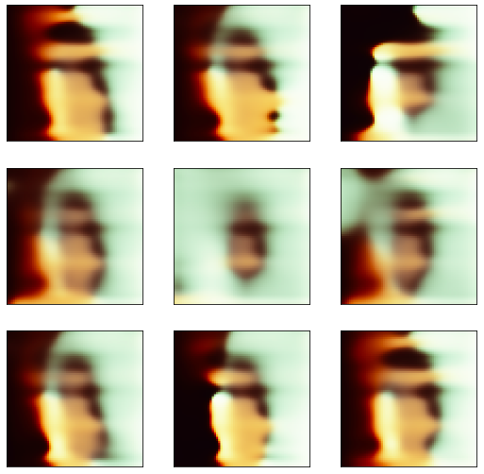
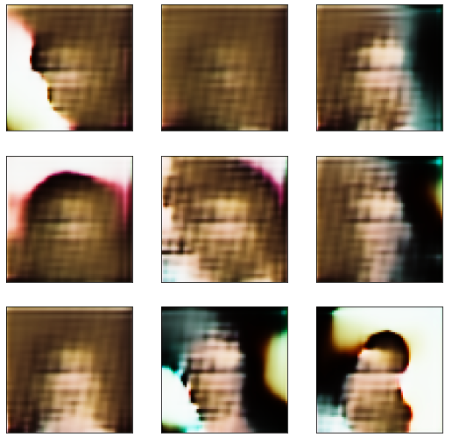
MY EXPERIMENT
fake images from the last epoch fake images from the last epoch
Real images Samples = 400 Samples = 2000

